Slide 1


ArcFace
AI-ML Project

Slide 2
Initial Stages
Problem Statement
Existing Techniques
Search for Papers
Arcface

Slide 3
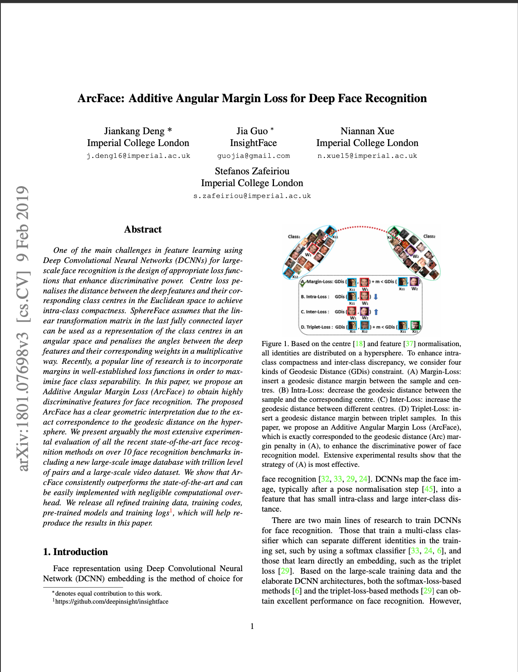
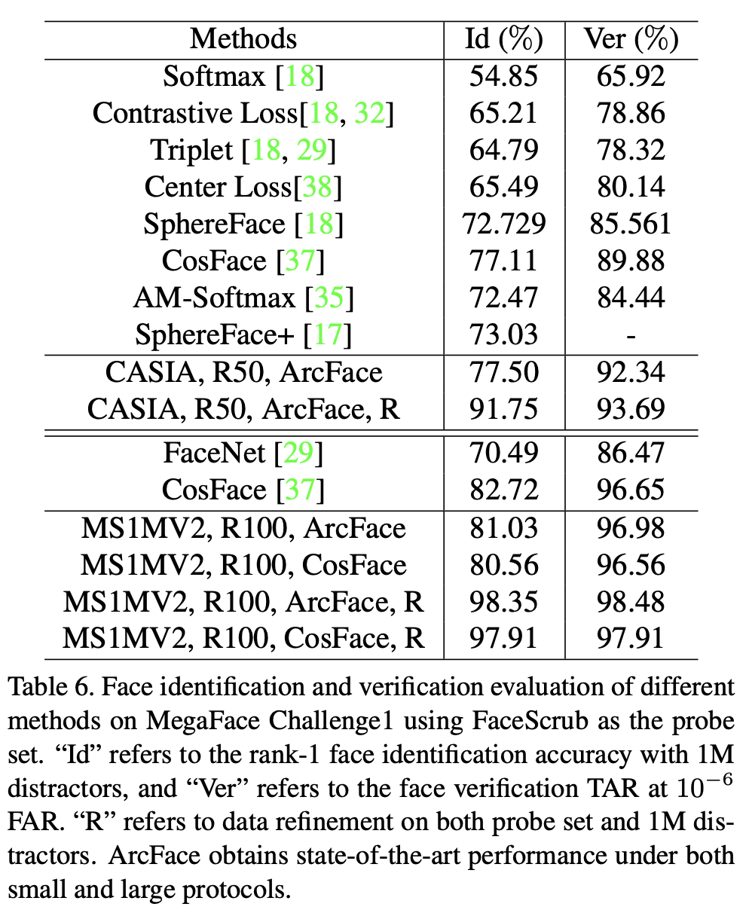
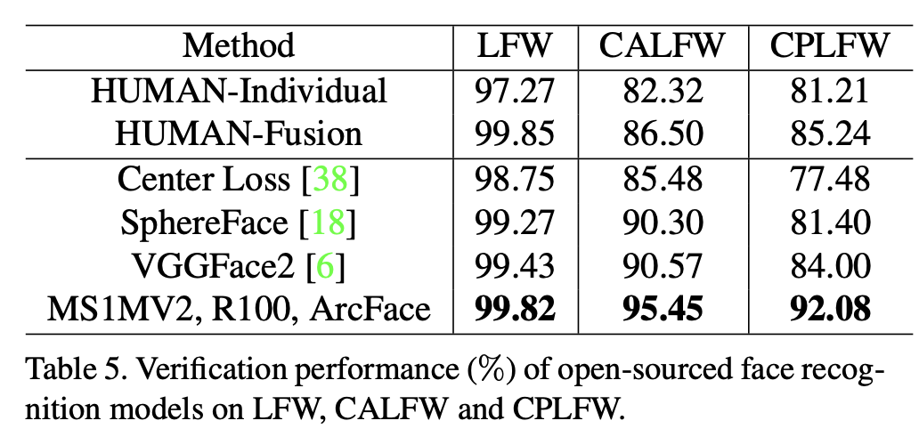
Arcface Paper & Performance
ArcFace: Additive Angular Margin Loss for Deep Face Recognition

Slide 4

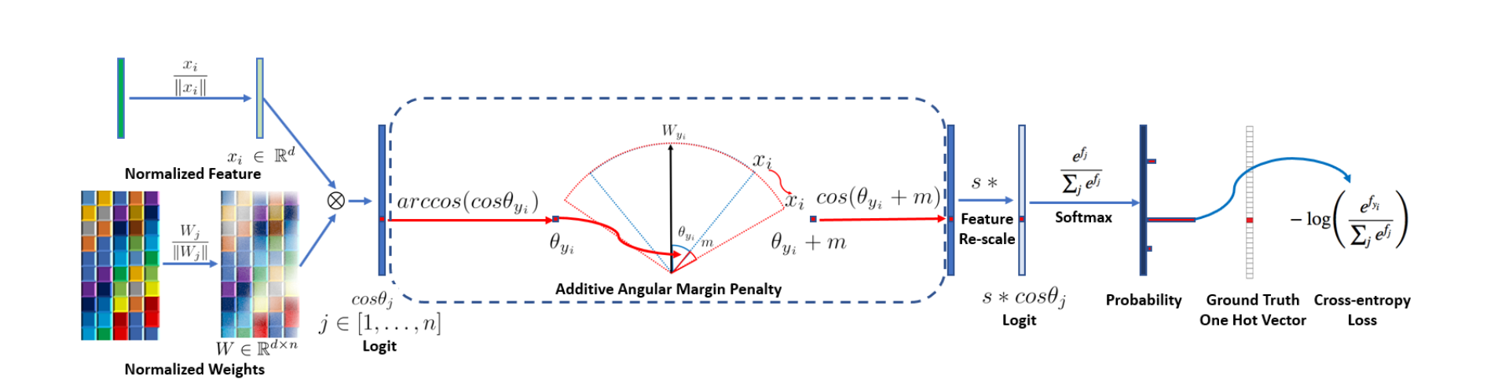

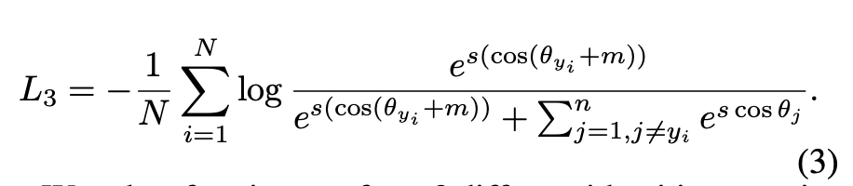
Arcface Loss

Slide 5
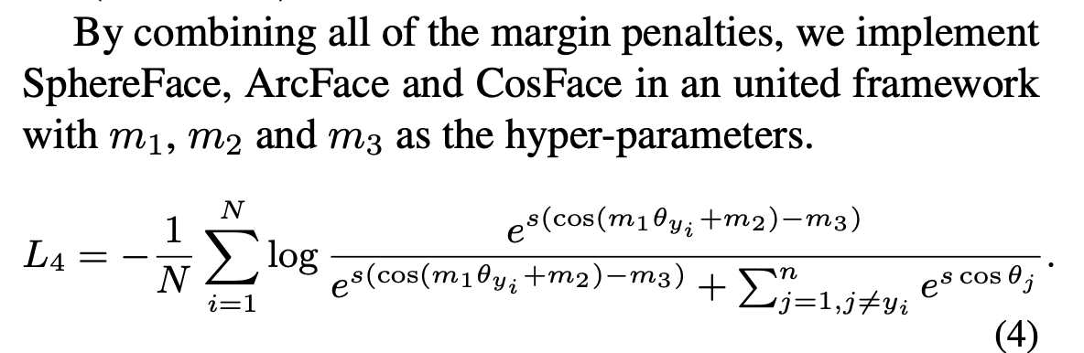
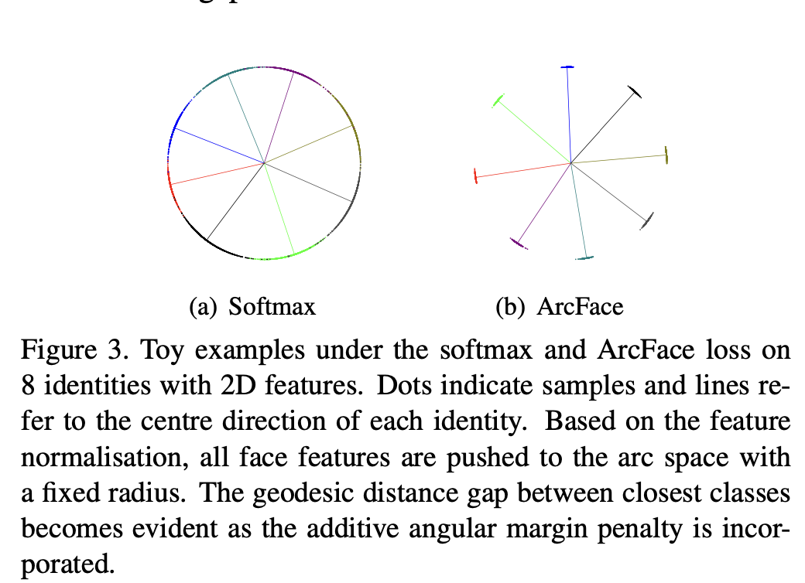
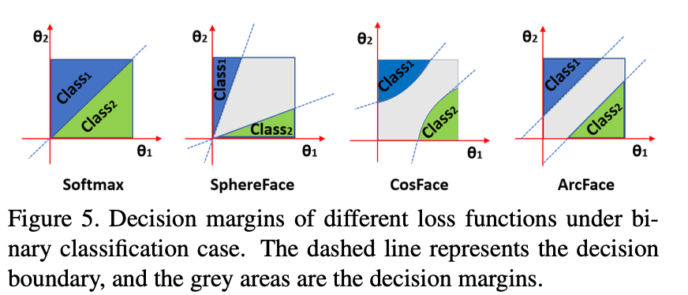
Comparison

Slide 6
Training 1
Dataset: Preprocessed LFW dataset
arccos: Method suggested in paper
Optimizer: Adam
Custom Training Loop
Saving formats

Slide 7
Training 2
Dataset: Preprocessed LFW dataset
Cos: Method seen in third party implementations
Optimizer: SGD

Slide 8
VISUALIZATION & INFERENCE

Slide 9
The Best Distance Metric
Cosine Distance
Normalized Embeddings' Cosine Distance
Euclidean Distance
Normalized Embeddings' Euclidean Distance

Slide 10
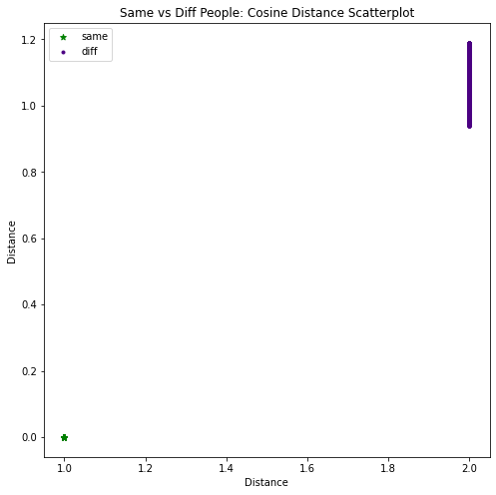
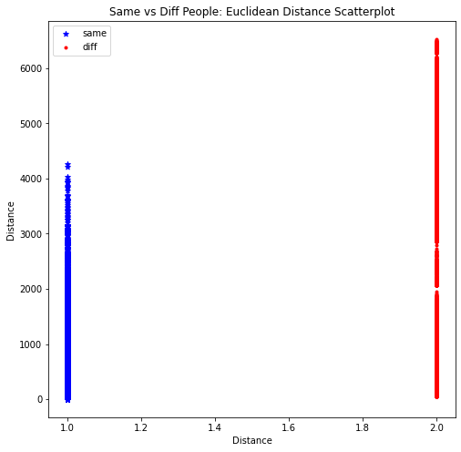
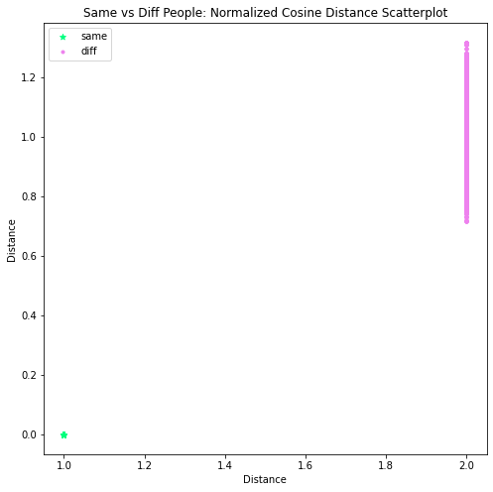
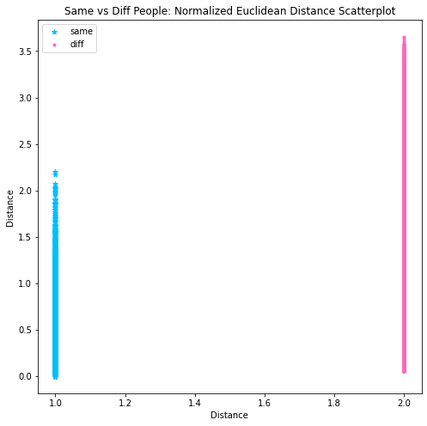

Slide 11
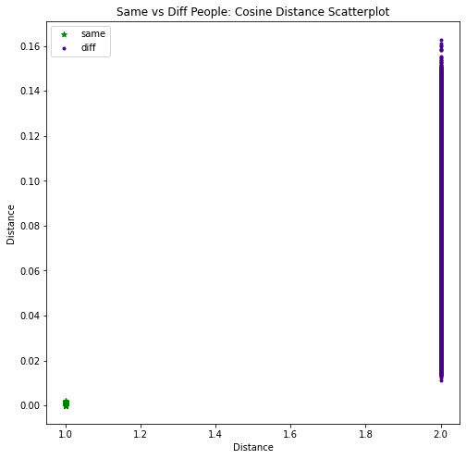
The Better Optimizer
Adam
SGD

Slide 12
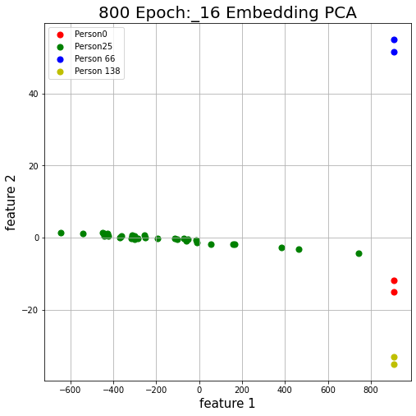
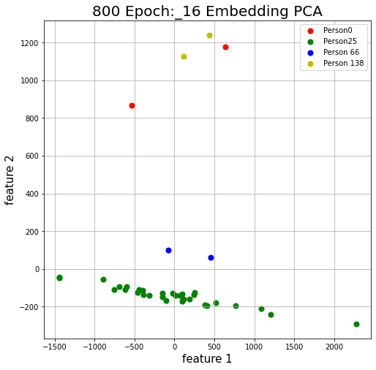
The Better Optimizer
Adam
SGD

Slide 13
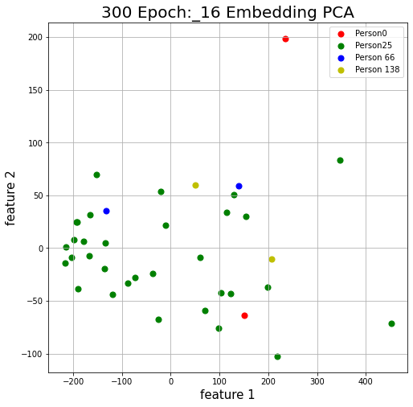
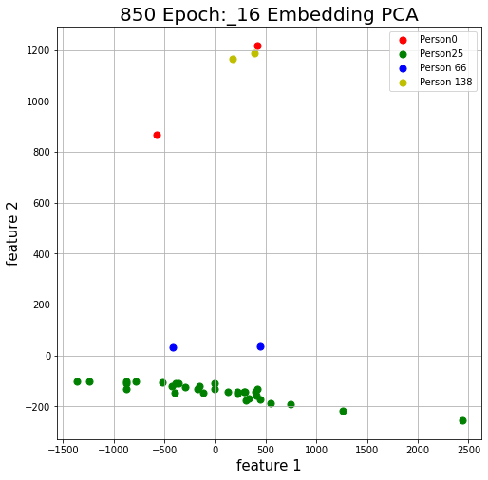
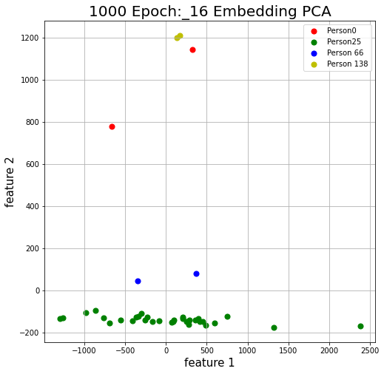
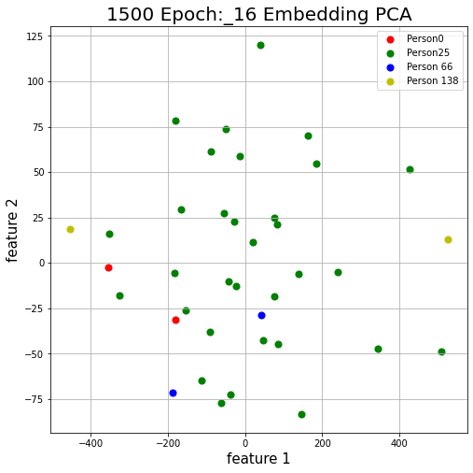
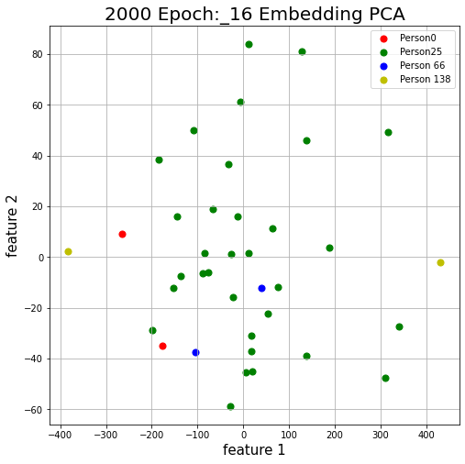
Performance as Epochs Progress
Cos Method, SGD, 16 dimensional embeddings

Slide 14
Best Model in Our Arsenal: arccos, Adam, 16 dim embedding, 800 epoch model

Slide 15
Using The Model
Face Recognition
Face Verification
Calculating Threshold
Code

Slide 16
Deployment
Using Gradio
Simple Interface
Demo

